Slide 1
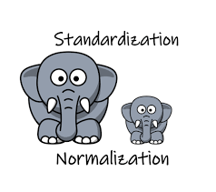
Standardization and Normalization
Deepak Mehta

Slide 2
Agendas
Feature Scaling Techniques
Normal Distribution
Standard Normal Distribution
Z-Score

Slide 3

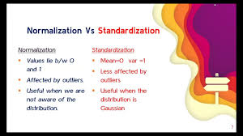
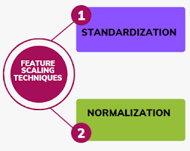
Feature Scaling Technique
Algorithms that compute the distance between the features are biased towards numerically larger values if the data is not scaled.
normalization and standardization will not change
the distribution of your data.

Slide 4
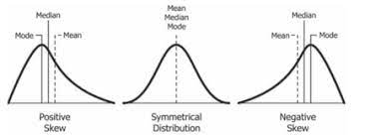
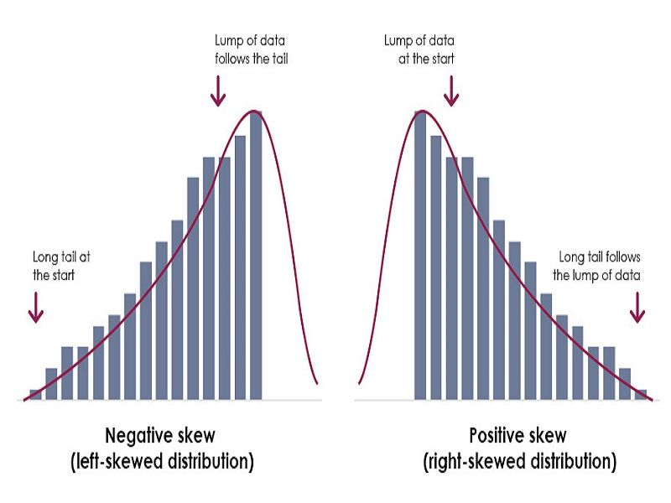
Skewness
Skewness is a measure of the asymmetry of a distribution. A distribution is asymmetrical when its left and right side are not mirror images.
A distribution can have right (or positive), left (or negative), or zero skewness
An example of a real life variable that has a skewed left distribution is age of death from natural causes (heart disease, cancer, etc.). Most such deaths happen at older ages, with fewer cases happening at younger ages.
Income distribution is a prominent example of positively skewed distribution. This is because a large percentage of the total people residing in a particular state tends to fall under the category of a low-income earning group, while only a few people fall under the high-income earning group. The mean of such data is generally greater than the other measures of central tendency of data such as median or mode

Slide 5
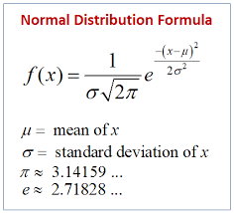
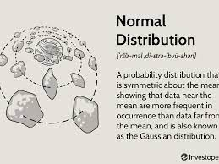
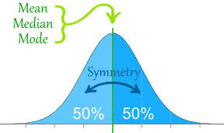
Gaussian/Normal Distribution
Normal distribution symmetrical bell-shaped curve. The area of curve is 1
Age, weight, Height follows normal distribution

Slide 6
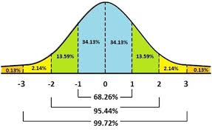
Empirical Rule (68-95-99.7% rule)
Within the first standard deviation b.w left and right there are around 68% of the entire data will be available to the first standard distribution from left to right
Within the 2nd standard distribution to the right and left around 95% of entire data falling in these region
Within the 3rd standard distribution to the right and left around 99.7% of the entire data falling in this region
With the help of q-q plot we can check whether distribution is normal or not

Slide 7
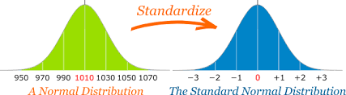
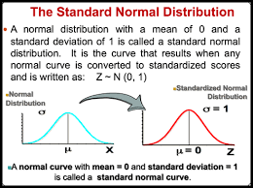
Standard Normal Distribution (SNR)
The standard normal distribution, also called the z-distribution, is a special normal distribution where the mean is 0 and the standard deviation is 1.
Any normal distribution can be standardized by converting its values into z-scores.
Z-scores tell you how many standard deviations from the mean each value lies

Slide 8
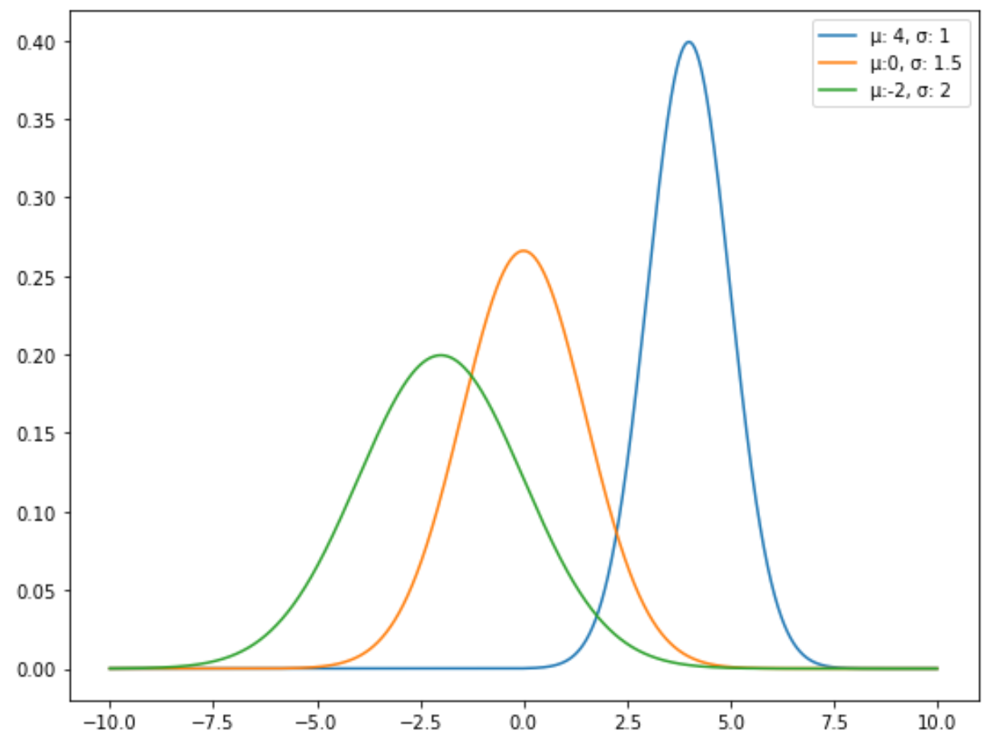
Properties
The normal distribution is the most commonly used probability distribution in statistics.
Symmetrical
Bell-shaped
Mean and median are equal; both located at the center of the distribution
The mean of the normal distribution determines its location and the standard deviation determines its spread.

Slide 9
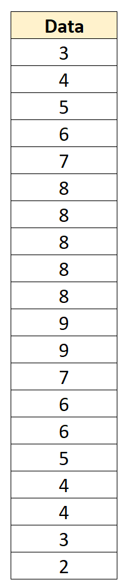
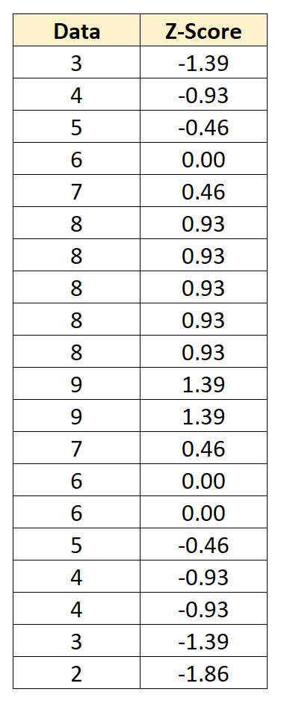
..continued
Any normal distribution can be converted into a standard normal distribution by converting the data values into z-scores, using the following formula:
z = (x – μ) / σ
Mean=6
SD=2.152

Slide 10
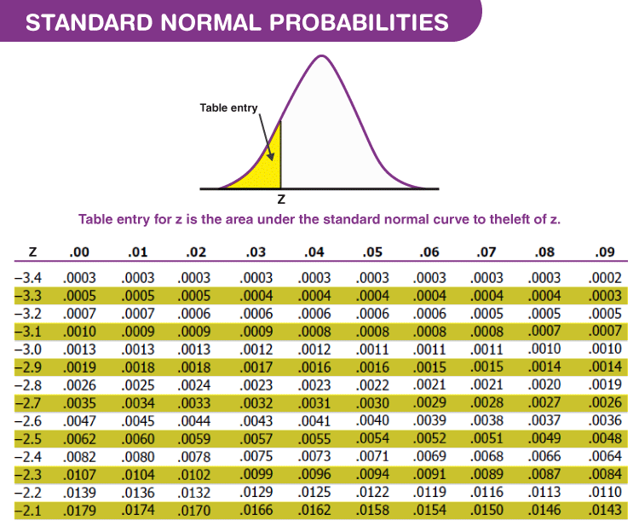
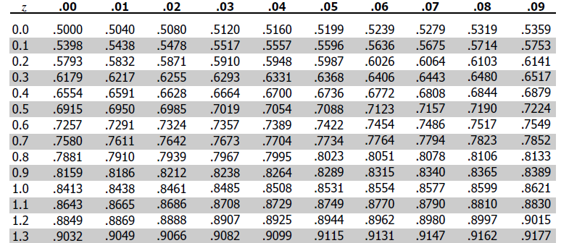
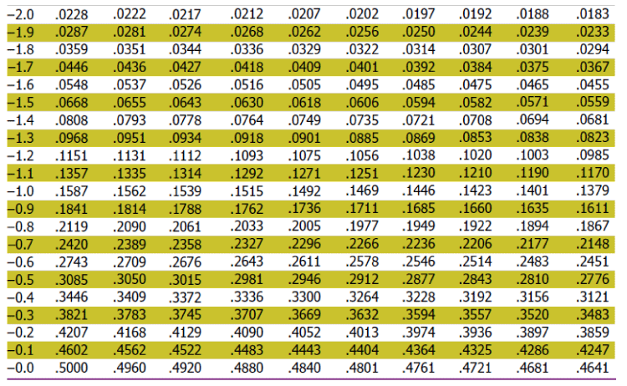
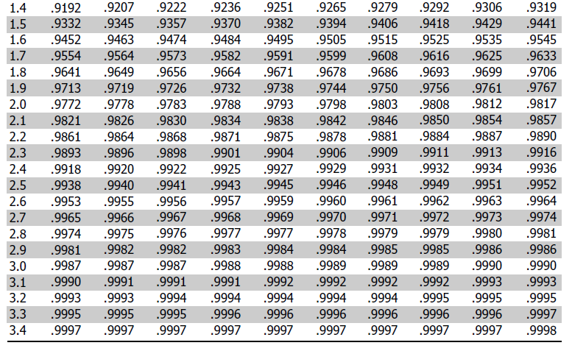
Z-Score Table (Standard Normal Table)

Slide 11
Exercise: For some computers, the time period between charges of the battery is normally distributed with a mean of 50 hours and a standard deviation of 15 hours. Rohan has one of these computers and needs to know the probability that the time period will be between 50 and 70 hours.
Let x be the random variable that represents the time period.
Given Mean, μ= 50
and standard deviation, σ = 15
To find: Probability that x is between 50 and 70 or P( 50< x < 70)
By using the transformation equation, we know;
z = (X – μ) / σ
For x = 50 , z = (50 – 50) / 15 = 0
For x = 70 , z = (70 – 50) / 15 = 1.33
P( 50< x < 70) = P( 0< z < 1.33) = [area to the left of z = 1.33] – [area to the left of z = 0]
From the table we get the value, such as;
P( 0< z < 1.33) = 0.9082 – 0.5 = 0.4082
The probability that Rohan’s computer has a time period between 50 and 70 hours is equal to 0.4082.

Slide 12
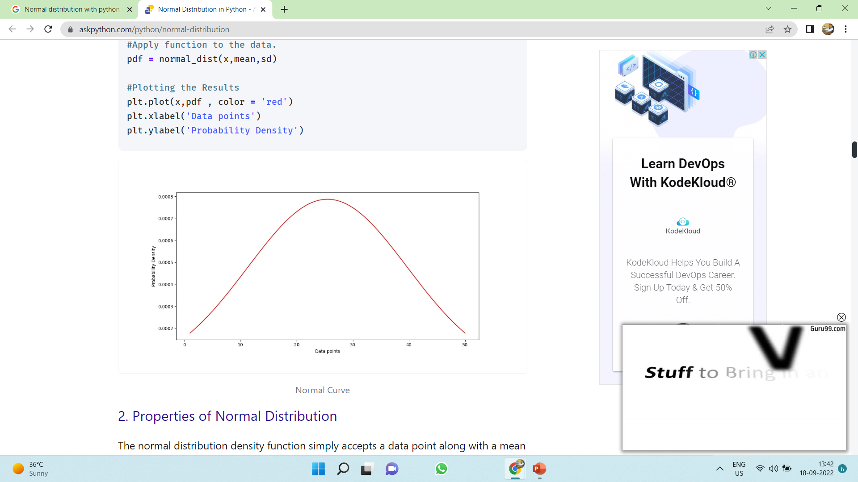
The normal distribution density function simply accepts a data point along with a mean value and a standard deviation and throws a value which we call probability density
import matplotlib.pyplot as plt
Import numpy as np
# Creating a series of data of in range of 1-50.
x = np.linspace(1,50,200)
#Creating a Function.
def normal_dist(x , mean , sd):
prob_density = (np.pi*sd) * np.exp(-0.5*((x-mean)/sd)**2)
return prob_density
#Calculate mean and Standard deviation.
mean = np.mean(x)
sd = np.std(x)
#Apply function to the data.
pdf = normal_dist(x,mean,sd)
#Plotting the Results
plt.plot(x,pdf , color = 'red')
plt.xlabel('Data points')
plt.ylabel('Probability Density')

Slide 13
Scipy Stat Norm library
# import required libraries from scipy.stats import norm import numpy as np import matplotlib.pyplot as plt import seaborn as sb # Creating the distribution data = np.arange(1,10,0.01) pdf = norm.pdf(data , loc = 5.3 , scale = 1 ) #Visualizing the distribution sb.set_style('whitegrid') sb.lineplot(data, pdf , color = 'black') plt.xlabel('Heights') plt.ylabel('Probability Density')
Loc : mean
Scale: Standard deviation

Slide 14
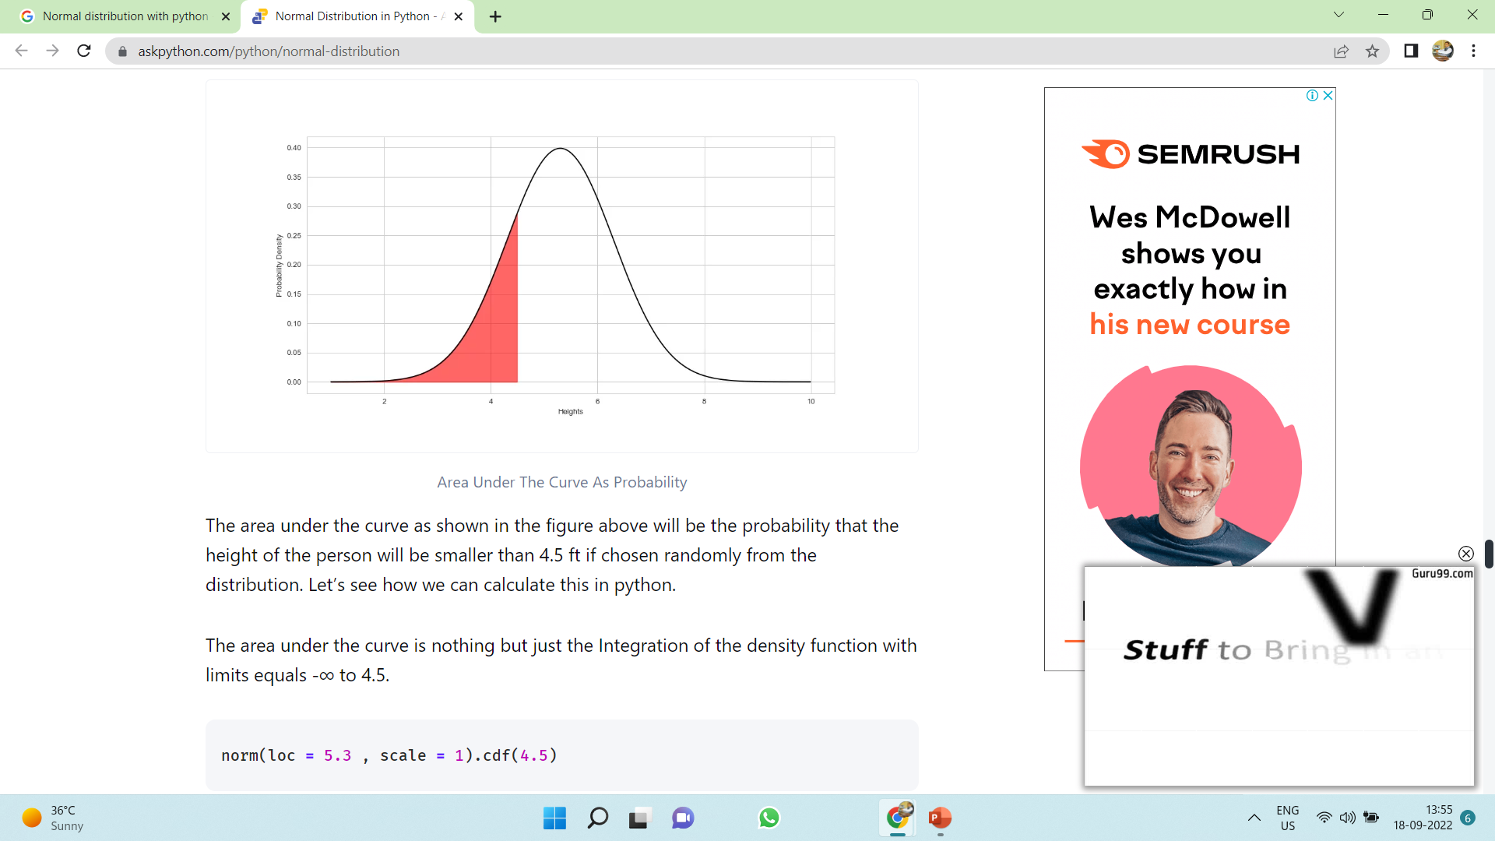
Calculating Probability of Specific Data Occurrence
pick one person randomly from this distribution, then what is the probability that the height of the person will be smaller than 4.5 ft
# import required libraries from scipy.stats import norm import numpy as np import matplotlib.pyplot as plt import seaborn as sb # Creating the distribution data = np.arange(1,10,0.01) pdf = norm.pdf(data , loc = 5.3 , scale = 1 ) #Probability of height to be under 4.5 ft. prob_1 = norm(loc = 5.3 , scale = 1).cdf(4.5) print(prob_1) #probability that the height of the person will be between 6.5 and 4.5 ft. cdf_upper_limit = norm(loc = 5.3 , scale = 1).cdf(6.5) cdf_lower_limit = norm(loc = 5.3 , scale = 1).cdf(4.5) prob_2 = cdf_upper_limit - cdf_lower_limit print(prob_2) #probability that the height of a person chosen randomly will be above 6.5ft cdf_value = norm(loc = 5.3 , scale = 1).cdf(6.5) prob_3 = 1- cdf_value print(prob_3)

Slide 15
Standardization: Why?
Standardization can be done using sklearn.preprocessing.StandardScaler module.
Consider two variables: years of study and salary.
Years of study will float somewhere between 1 to 30, the salary variable will be within the tens of thousands range
Take Machine learning, Linear Regression algorithm will calculate the coefficients, naturally it will give a higher number to salary in opposition to years of study.
But we know we don’t want the model to make that differentiation, so we can standardize the data to put them in the same scale.

Slide 16
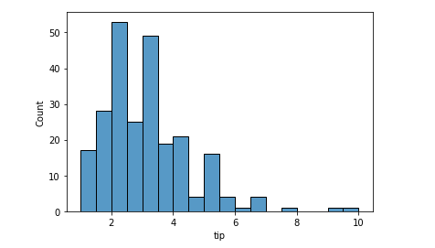
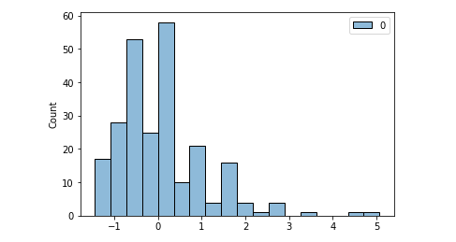
Standardization: Distribution Shape doesn’t Affected
import pandas as pd import seaborn as sns from sklearn.preprocessing import StandardScaler, normalize import scipy.stats as scs# Pull a dataset df = sns.load_dataset('tips')# Histogram of tip variable sns.histoplot(data=df, x='tip');
scaler = StandardScaler() scaled = scaler.fit_transform(df[['tip’]])
print(f'Mean: {scaled.mean().round()} | Std: {scaled.std().round()}’)
sns.histplot(scaled);

Slide 17
Normalization
Normalization or Min-Max Scaling is used to transform features to be on a similar scale.
The new point is calculated as: X_new = (X - X_min)/(X_max - X_min)
Normalization is useful when there are no outliers as it cannot cope up with them.
Usually, we would scale age and not incomes because only a few people have high incomes but the age is close to uniform.
from sklearn.preprocessing import MinMaxScaler
scaledData = MinMaxScaler().fit_transform(data)
# Printing the Normalized Data
print(scaledData)

Slide 18
Normalization vs Standardization
S.NO. | Normalization | Standardization
1. | Minimum and maximum value of features are used for scaling | Mean and standard deviation is used for scaling.
2. | It is used when features are of different scales. | It is used when we want to ensure zero mean and unit standard deviation.
3. | Scales values between [0, 1] or [-1, 1]. | It is not bounded to a certain range.
4. | It is really affected by outliers. | It is much less affected by outliers.
5. | Scikit-Learn provides a transformer called MinMaxScaler for Normalization. | Scikit-Learn provides a transformer called StandardScaler for standardization.
6. | This transformation squishes the n-dimensional data into an n-dimensional unit hypercube. | It translates the data to the mean vector of original data to the origin and squishes or expands.
7. | It is useful when we don’t know about the distribution | It is useful when the feature distribution is Normal or Gaussian.
8. | It is a often called as Scaling Normalization | It is a often called as Z-Score Normalization.

Slide 19
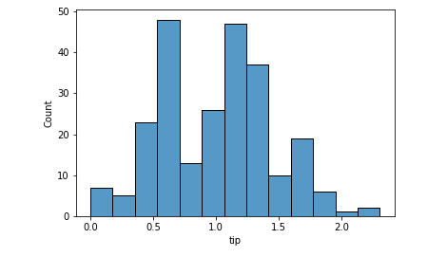
Log Transformation: Normal Distribution
There is a transformation that can change the shape of your data and make it to approximate of a normal distribution. That is the logarithmic transformation.
The log transformation will remove the skewness of a dataset
because it puts everything in perspective.
The variances will be proportional rather than absolute, thus the
shape changes and resembles a normal distribution.
# Log transform and Normality scs.shapiro(df.tip.apply(np.log))
[OUT]: (0.9888471961021423, 0.05621703341603279) p-Value > 0.05 : Data is normal
# Histogram after Log transformation sns.histplot(df.tip.apply(np.log) );

Slide 20
Thanks
Deepak.e11296@cumail.in
9812881611

